Slide 1
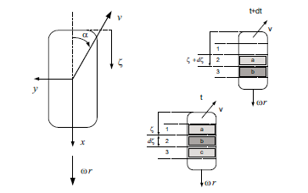
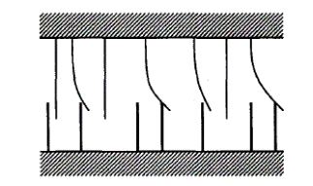
Automotive Vehicle Dynamics
Tire Modeling 3 – LuGre Tire Model
Sean Brennan
Department of Mechanical and Nuclear Engineering
Penn State University
sbrennan@psu.edu

Slide 2
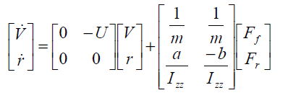
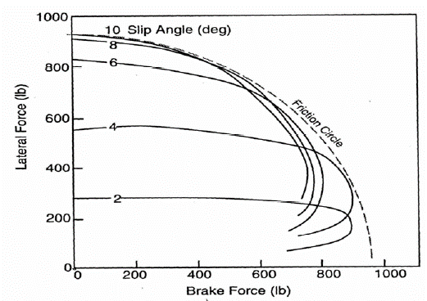
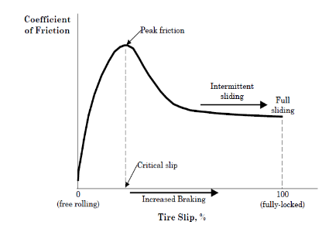
A tire model is essential for vehicle dynamics simulation and control design.
Lateral Force
Interaction of both forces
Reference: Gillespie (1992); NCHRP 1-43; Hamblin (2007)
Longitudinal Force

Slide 3
Tire models have different level of accuracy and complexity. They can be classified as:
Empirical models: Fitting full scale tire test data by regression techniques e.g. magic tire model
Similarity method based model: Using distortion, rescaling and multiplications of one measured curve, new relationships to describe off-nominal conditions
Simple physics-based model: Using simple mechanical representation, possibly closed form solution e.g. Dugoff model, LuGre model
Complex physics-based model: Describing tire in great detail, computer simulation and finite element method
The choice of tire model depends on the application.
Reference: Pacejka, H.B., Tire and Vehicle Dynamics, SAE International, 2006

Slide 4
Ultimately, the goal of PHYSICAL modeling of tires is to capture friction effects
Let’s assume the tire is a spring pressing against the pavement. The spring will deform AND slide, and both effects produce force.
Vehicle

Slide 5
There are many types of friction!
(This slide is modified from Gurkan Erdogan. His lecture is amazing!)

Slide 6
The Stribeck effect (1902) explains that friction decreases with increasing velocity for small velocities
Stribeck effect
Zoom in, since interesting stuff is happening here
(this slide is also modified from Gurkan Erdogan)

Slide 7
Tire forces start with elasticity, which is governed by Hooke’s law. Tires are in general VERY elastic.
(this slide is modified from Gurkan Erdogan)

Slide 8
But if the spring is connected to something that allows relative velocity (sliding), we have elongation regimes (slip) and sliding regimes, e.g. a combination of elasticity and frictional slipping
(this slide is modified from Gurkan Erdogan)

Slide 9
The LuGre (Lund-Grenoble) tire model is a simple but widely used physics-based tire model.
Dynamic friction model was originally developed for control of systems with friction
There are two main insights
Model forces by studying deflection of bristles: z
Use a “stiction” model, a velocity- dependent blending of sliding and coulomb friction
Together, these take into account
Coulomb Friction: Static friction of tire
Viscous Friction: Friction component proportional to velocity
Stribeck Effect: Friction reduction with velocity
Reference: De Wit et al, A New Model for Control of Systems with Friction, IEEE transactions on Automatic Control, Vol 40, no. 3, 1995

Slide 10




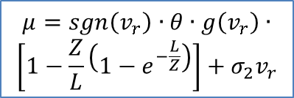








Procedure to calculate effective friction (1D case)
Calculate Relative Velocity
Calculate Stribeck Friction
Calculate Bristle Deflection
Calculate Bristle Friction
$$μ=sgn\left(v_{r}\right)∙θ∙g\left(v_{r}\right)∙$$
$$\left[1−\frac{Z}{L}\left(1−e^{−\frac{L}{Z}}\right)\right]+σ_{2}v_{r}$$
Slip
$$g\left(v_{r}\right)$$
$$Z$$
$$μ$$
Velocity
Bristle
Stiffness
$$σ_{0}$$
Coulomb
Friction
$$μ_{c}$$
$$Z=\frac{g(v_{r})}{σ_{0}}\frac{\left|S+1\right|}{\left|S\right|}$$
Stiction
Friction
$$μ_{s}$$
Tire contact
length
$$L$$
Stribeck
Velocity
$$v_{s}$$
Hydroplaning
Correction
$$θ$$
$$g\left(v_{r}\right)=μ_{c}+\left(μ_{s}−μ_{c}\right)e^{−{\left|{v_{r}}/{v_{s}}\right|}^{α}}$$
$$σ_{2}$$
Bristle
Viscosity

Slide 11
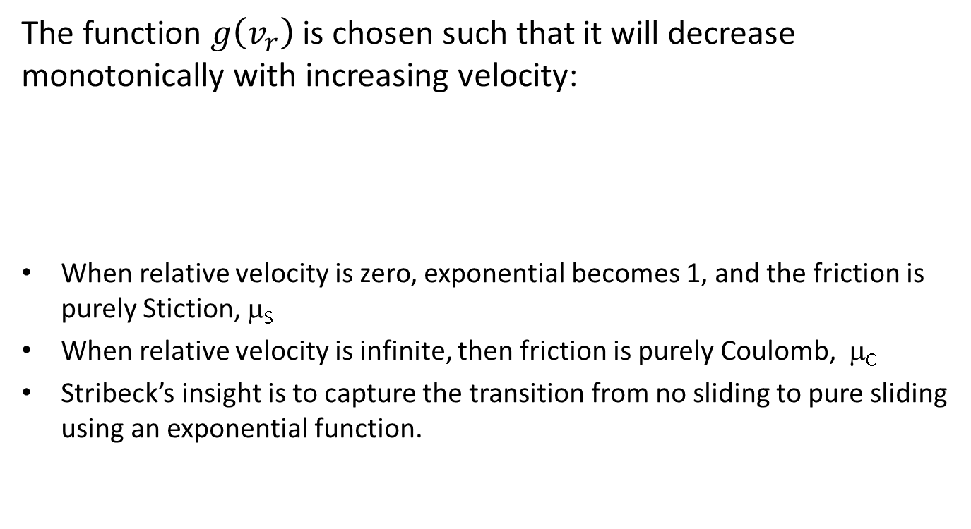

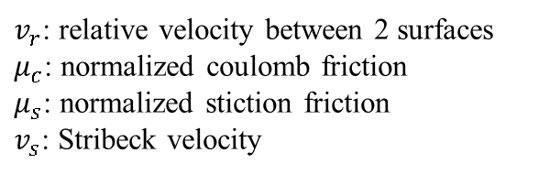
To understand this model, we examine it term-by-term, starting with the Stribeck formula
The function $g\left(v_{r}\right)$ is chosen such that it will decrease monotonically with increasing velocity:
When relative velocity is zero, exponential becomes 1, and the friction is purely Stiction, μ_{S}
When relative velocity is infinite, then friction is purely Coulomb, μ_{C}
Stribeck’s insight is to capture the transition from no sliding to pure sliding using an exponential function.
$v_{r}$: relative velocity between 2 surfaces
$μ_{c}$: normalized coulomb friction
$μ_{s}$: normalized stiction friction
$v_{s}$: Stribeck velocity
$$g\left(v_{r}\right)=μ_{c}+\left(μ_{s}−μ_{c}\right)e^{−{\left|{v_{r}}/{v_{s}}\right|}^{1/2}}$$
Reference: De Wit et al, A New Model for Control of Systems with Friction, IEEE Transactions on Automatic Control, Vol. 40, No. 3, 1995
De Wit et al, Dynamic Tire Friction Models for Vehicle Traction Control, IEEE Conf on Decision and Control, 1999.

Slide 12
The Stribeck velocity is a characteristic of a material-material interaction that predicts transition from stiction to coulomb behavior
For rigid materials (like steel), the stribeck velocity is so small that the coulomb model is usually sufficient. For flexible materials (like tires), the stribeck velocity is quite high and so one must model both stribeck and coulomb behaviors.
% Stribeck Model
clear all; close all;
% Friction Parameters
mu_C =0.8; % Coulomb friction of tire, unitless
mu_S=1.5; % Stribeck friction of tire, unitless
v_r = [0:0.2:10]'; % Vector of relative velocities, in m/s
for v_s = [1:5] % Vary stribeck velocities
% Calculate stribeck curve
g_v=(mu_C+(mu_S-mu_C)*exp(-(abs(v_r./v_s)).^0.5));
plot(v_r,g_v,'k'); hold on; % Plot results
end
% Label everything
title('Stribeck friction with changing stribeck velocities, \mu_C = 0.8, \mu_S = 1.5');
xlabel('Relative velocity, v_r (m/s)');
ylabel('Stribeck friction, g(v_r) (unitless)')
text(2,0.9,'v_s = 1');
text(6,1.07,'v_s = 5');

Slide 13
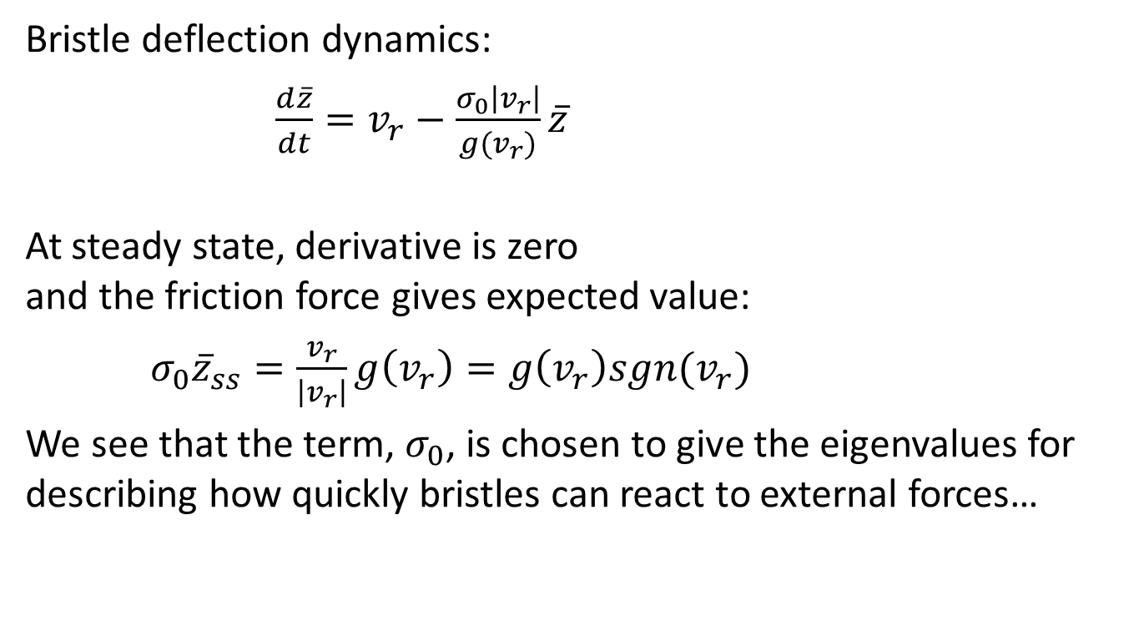
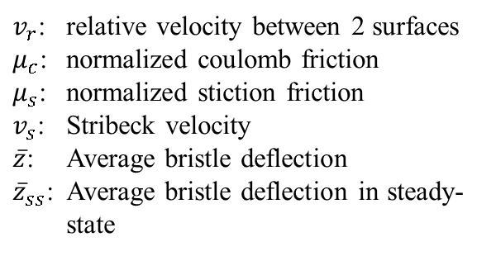
The next step is to calculate bristle deflection due to relative velocity…
$v_{r}$: relative velocity between 2 surfaces
$μ_{c}$: normalized coulomb friction
$μ_{s}$: normalized stiction friction
$v_{s}$: Stribeck velocity
$\overline{z}$: Average bristle deflection
${\overline{z}}_{ss}$: Average bristle deflection in steady-state
Bristle deflection dynamics:
$\frac{d\overline{z}}{dt}=v_{r}−\frac{σ_{0}\left|v_{r}\right|}{g(v_{r})}\overline{z}$
At steady state, derivative is zero and the friction force gives expected value:
$σ_{0}{\overline{z}}_{ss}=\frac{v_{r}}{\left|v_{r}\right|}g\left(v_{r}\right)=g\left(v_{r}\right)sgn(v_{r})$
We see that the term, $σ_{0}$, is chosen to give the eigenvalues for describing how quickly bristles can react to external forces…
Reference: De Wit et al, Dynamic Tire Friction Models for Vehicle Traction Control, IEEE Conf on Decision and Control, 1999.

Slide 14
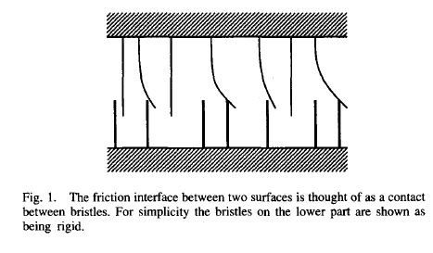
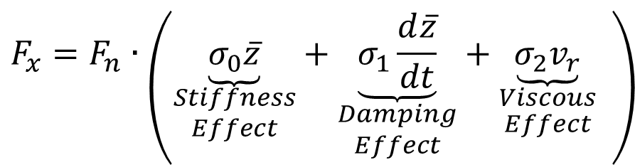
The Bristle deflection give the tire force
The bristle force is given by:
$$F_{x}=F_{n}∙\left(\underset{\begin{aligned}Stiffness \\ Effect\end{aligned}}{\underbrace{σ_{0}\overline{z}}}+\underset{\begin{aligned}Damping \\ Effect\end{aligned}}{\underbrace{σ_{1}\frac{d\overline{z}}{dt}}}+\underset{\begin{aligned}Viscous \\ Effect\end{aligned}}{\underbrace{σ_{2}v_{r}}} \right)$$
References: De Wit et al, A New Model for Control of Systems with Friction, IEEE transactions on Automatic Control, Vol 40, no. 3, 1995
De Wit et al, Dynamic Tire Friction Models for Vehicle Traction Control, IEEE Conf on Decision and Control, 1999.
De Wit et al, Dynamic Friction Models for Road/Tire Longitudinal Interaction, Vehicle System Dynamics, Vol 39, no 3, 2003

Slide 15
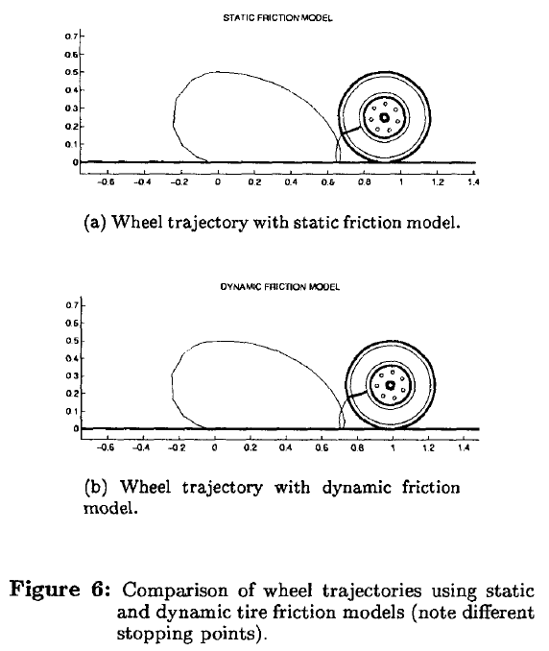
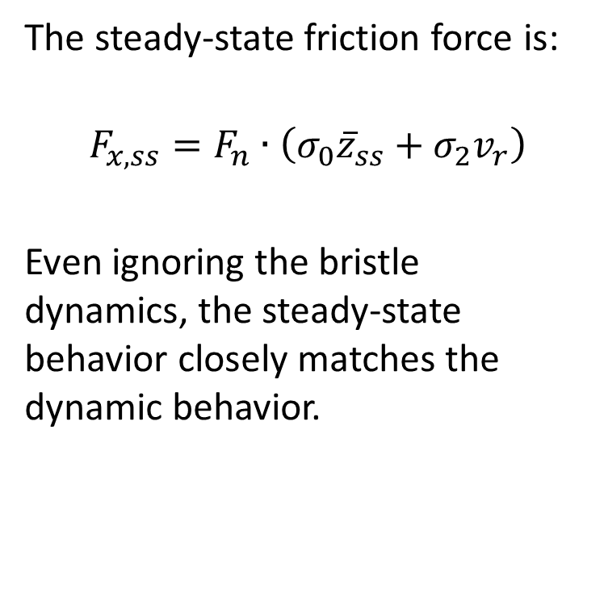
The dynamics of bristle deflection are usually small
The steady-state friction force is:
$$F_{x,ss}=F_{n}∙\left(σ_{0}{\overline{z}}_{ss}+σ_{2}v_{r}\right)$$
Even ignoring the bristle dynamics, the steady-state behavior closely matches the dynamic behavior.
Reference:
De Wit et al, Dynamic Friction Models for Road/Tire Longitudinal Interaction, IEEE transactions on Automatic Control, 1999
(plot) De Wit et al, Dynamic Tire Friction Models for Vehicle Traction Control, IEEE Conf on Decision and Control, 1999.

Slide 16
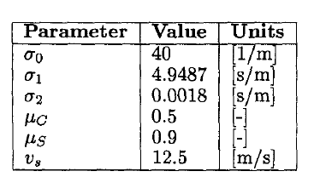
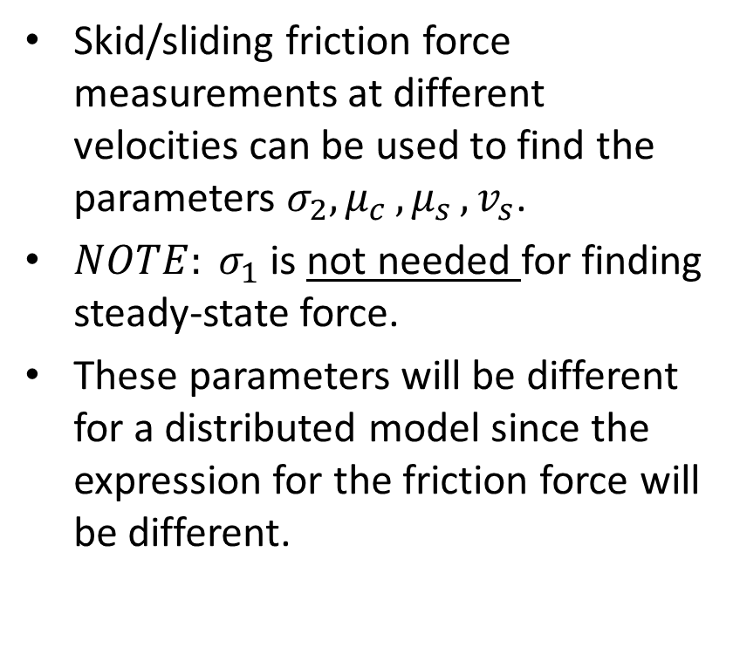
Measurement of LuGre parameters is relatively easy (don’t need a tire!)
Skid/sliding friction force measurements at different velocities can be used to find the parameters $σ_{2}{,μ}_{c}{,μ}_{s}{,v}_{s}$.
$NOTE: σ_{1}$ is not needed for finding steady-state force.
These parameters will be different for a distributed model since the expression for the friction force will be different.
Reference:
De Wit et al, Dynamic Tire Friction Models for Vehicle Traction Control, IEEE Conf on Decision and Control, 1999.

Slide 17
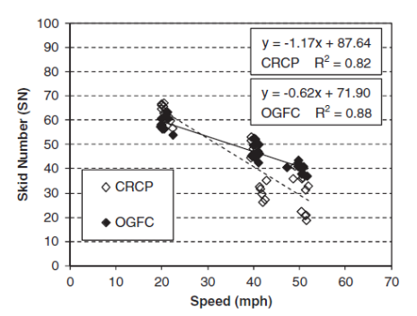
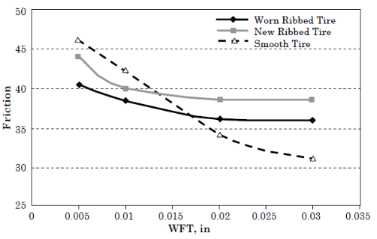


Coefficient of road adhesion/friction on a wet road depends on vehicle velocity and water film depth (WFT).
Friction is usually reported in Skid Number, $SN=100∙μ$
We can add water depth friction loss via correction term to g(v):
$$gcorrected\left(v_{r}\right)=θ∙g\left(v_{r}\right)$$
Reference: Flintsch, G.W. et al., Speed Adjustment Factors for Locked-Wheel Skid Trailer Measurements, Transportation Research Record 2155, P. 117-13, Washington D.C., 2010; NCHRP 1-43.

Slide 18

Correcting for water depth is as simple as changing g(v_{r})
We can add water depth friction loss via correction term to g(v):
Factor $θ$ represents reduction in friction coefficient
$$gcorrected\left(v_{r}\right)=θ∙g\left(v_{r}\right)$$
Reference:
Flintsch, G.W. et al., Speed Adjustment Factors for Locked-Wheel Skid Trailer Measurements, Transportation Research Record 2155, P. 117-13, Washington D.C., 2010; NCHRP 1-43.

Slide 19
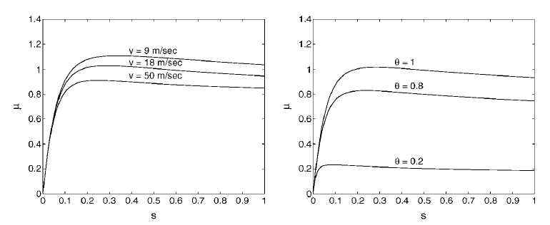
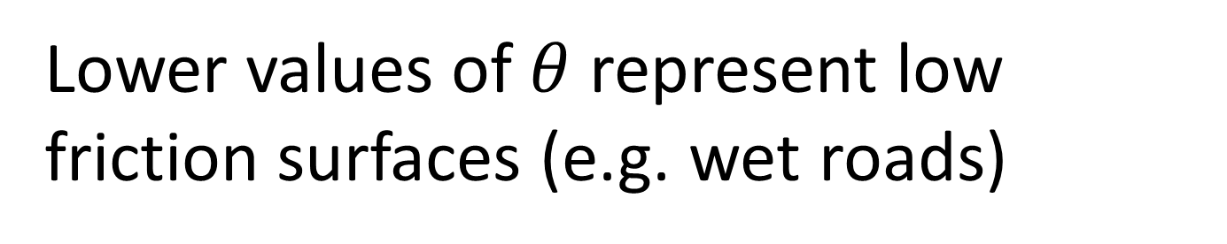
Lower values of $θ$ represent low friction surfaces (e.g. wet roads)
Reference: 2003, De Wit et al., Dynamic Friction Models for Road-Tire Longitudinal Interaction
Is road friction constant with speed, for wet roads?
What do you notice about the cornering stiffness for each case?

Slide 20
Outline
Introduction
1D LuGre model
2D/Combined LuGre model
Results from combined LuGre model

Slide 21
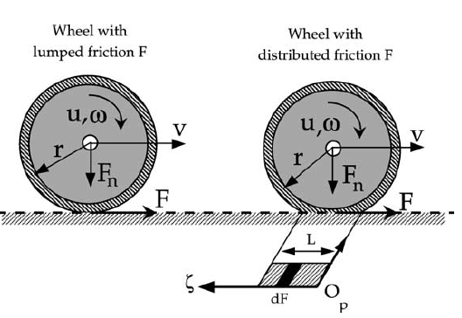
Distributed LuGre model assumes existence of a contact patch, unlike lumped model
Reference:
De Wit et al., Dynamic Friction Models for Road-Tire Longitudinal Interaction, Vehicle System Dynamics, Vol 39, No 3, pg 189-226. 2003.

Slide 22
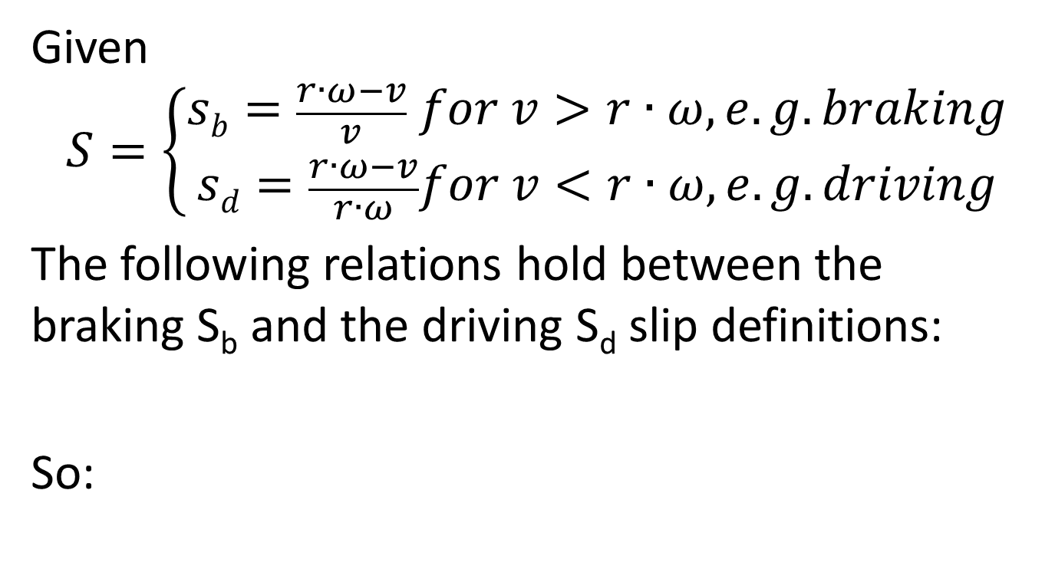


Slip in driving versus braking
Given
$$S=\left\{\begin{matrix}sb=\frac{r∙ω−v}{v} for v>r∙ω, e.g. braking \\ sd=\frac{r∙ω−v}{r∙ω}for v<r∙ω, e.g.driving\end{matrix}\right.$$
The following relations hold between the braking S_{b} and the driving S_{d} slip definitions:
So:
$$r∙ω∙s_{d}=v∙s_{b}$$
$$sd=\frac{sb}{1+sb}$$

Slide 23
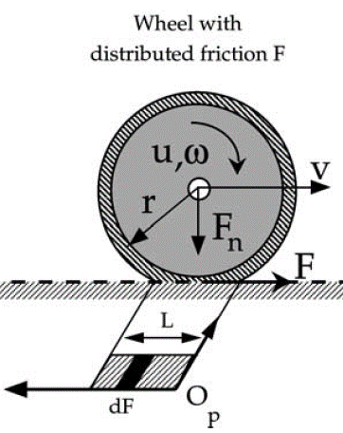

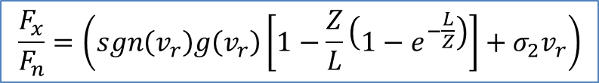


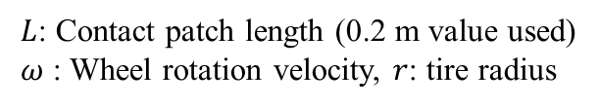
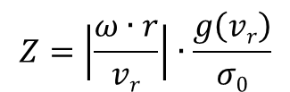
Net force can be obtained by integrating force at each bristle along tire contact patch.
The steady-state result for distributed model, assuming a constant normal load distribution over the contact patch, is
with
$$\frac{F_{x}}{F_{n}}=\left(sgn\left(v_{r}\right)g\left(v_{r}\right)\left[1−\frac{Z}{L}\left(1−e^{−\frac{L}{Z}}\right)\right]+σ_{2}v_{r}\right)$$
$$z$$
$$Z=\left|\frac{ω∙r}{vr}\right|∙\frac{g\left(vr\right)}{σ0}$$
$=\left|\frac{1}{S}\right|∙\frac{g\left(vr\right)}{σ0}$ for driving
$L$: Contact patch length (0.2 m value used)
𝜔 : Wheel rotation velocity, 𝑟: tire radius
$=\left|\frac{1+S}{S}\right|∙\frac{g\left(vr\right)}{σ0}$ for braking
Reference:
De Wit et al., Dynamic Friction Models for Road-Tire Longitudinal Interaction, Vehicle System Dynamics, Vol 39, No 3, pg 189-226. 2003. (see equations 49 and 50)

Slide 24
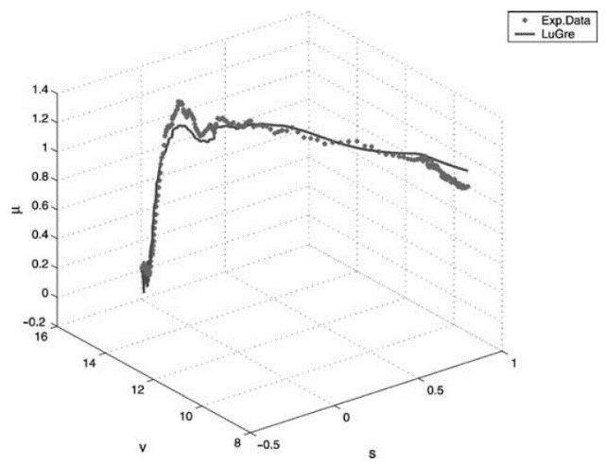
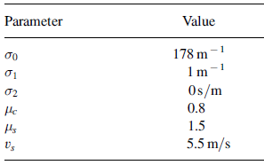

LuGre parameters from tire materials match tire data EXTREMELY well.
Below parameters obtained from comparison with experimental data, but we regularly use friction testing devices (Circular Texture Meters and Dynamic Friction measurement, or CTM / DF)
For LuGre model, braking force depends on velocity! (which REALLY happens but is ignored in other models)
Use: L=0.2 m, $α$=0.5
v
λ
Reference:
De Wit et al., Dynamic Friction Models for Road-Tire Longitudinal Interaction, Vehicle System Dynamics, Vol 39, No 3, pg 189-226. 2003.

Slide 25
MATLAB Code
v= 10 m/s
% LuGre Model
clear all;
v=10; %Linear Velocity, m/s
%LuGre Parameters
sigma_0=178; %1/m
sigma_2=0; %s/m
mu_C=0.8; mu_S=1.5;
v_s=5.5; %Stribeck velocity in m/s
L=0.2; %contact patch length (assume 0.2 m for ALL cases)
theta=1;
for i=1:1:100
s=-i*0.01; %slip defined negative for braking in the model
v_r=-s*v; %relative velocity
g_v=(mu_C+(mu_S-mu_C)*exp(-(abs(v_r/v_s))^0.5));
%for wet pavement: g_v=theta*(mu_C+(mu_S-mu_C)*exp(-(abs(v_r/v_s))^0.5));
%g(v_r):calling it g_v so that no confusion with gravity
Z=g_v*abs(1+s)/sigma_0/abs(s);
mu_x(i)=sign(v_r)* theta *g_v*(1-Z/L*(1-exp(-L/Z)))+sigma_2*v_r; %mu=Fx/Fn
end
slip=0.01:0.01:1;
plot(slip,mu_x); xlabel('longitudinal slip');ylabel('mu_x');

Slide 26
Velocity dependence matches what we see in field measurements
One can easily modify the previous code to plot velocities at [10, 20, 30, 40, 50 m/s] at left, or at fixed slip (0.1) for speeds 0:50 m/s at right…
Both follow trends seen in field measurements of friction

Slide 27
Outline
Introduction
1D LuGre model
2D/Combined LuGre model
Results from combined LuGre model

Slide 28
I’m not going to lie… the combined 2-D LuGre model is HARD. You are not expected to follow every detail that follows, but if you use this model, you will find these slides helpful.

Slide 29
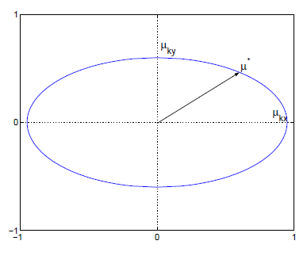
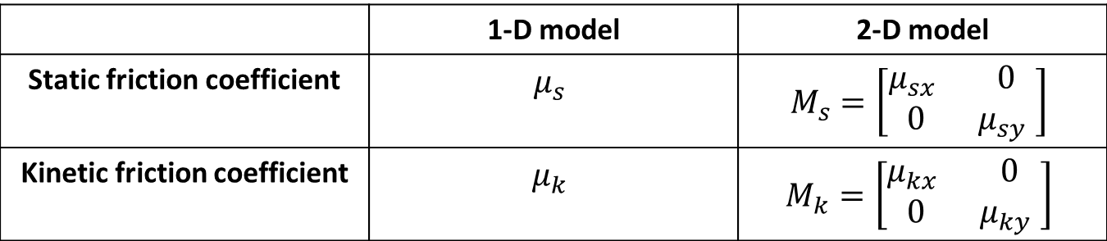
Combined LuGre considers coupling of X,Y forces as well as anisotropic effect
 | 1-D model | 2-D model
Static friction coefficient | $$μ_{s}$$ | $$M_{s}=\left[\begin{matrix}μ_{sx} & 0 \\ 0 & μ_{sy} \end{matrix}\right]$$
Kinetic friction coefficient | $$μ_{k}$$ | $$M_{k}=\left[\begin{matrix}μ_{kx} & 0 \\ 0 & μ_{ky} \end{matrix}\right]$$
Anisotropic effect: Friction coefficients in x and y direction can be chosen differently.
Reference: Velenis et al., Extension of the LuGre model to 2D motion, 2002.

Slide 30
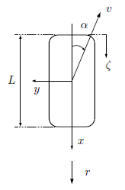
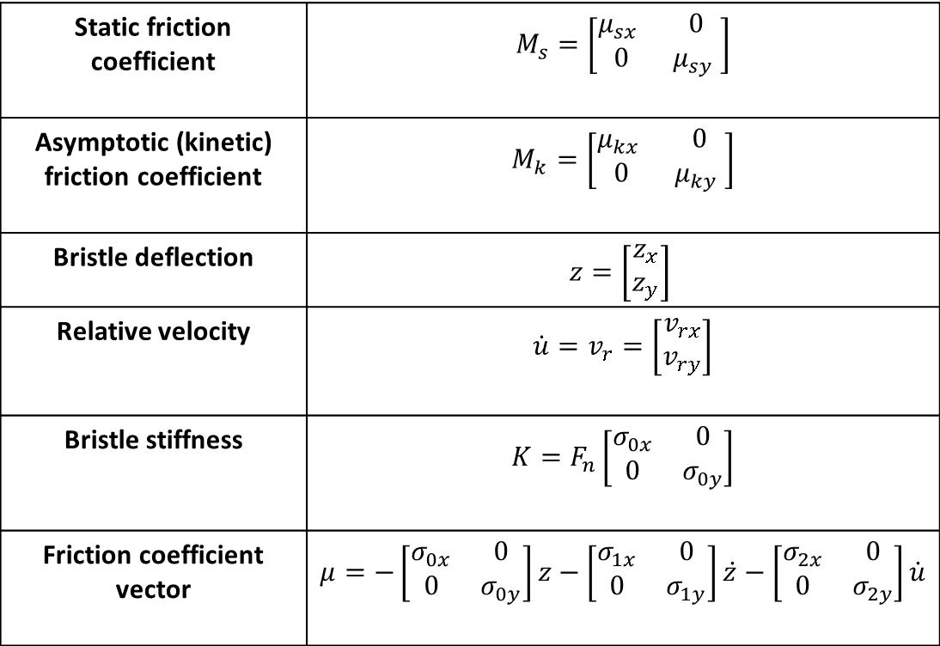
For combined model, all parameters are represented in vector (2D) form
Static friction coefficient | $$M_{s}=\left[\begin{matrix}μ_{sx} & 0 \\ 0 & μ_{sy} \end{matrix}\right]$$
Asymptotic (kinetic) friction coefficient | $$M_{k}=\left[\begin{matrix}μ_{kx} & 0 \\ 0 & μ_{ky} \end{matrix}\right]$$
Bristle deflection | $$z=\left[\begin{matrix}z_{x} \\ z_{y}\end{matrix}\right]$$
Relative velocity | $$\dot{u}=v_{r}=\left[\begin{matrix}v_{rx} \\ v_{ry}\end{matrix}\right]$$
Bristle stiffness | $$K=F_{n}\left[\begin{matrix}σ_{0x} & 0 \\ 0 & σ_{0y}\end{matrix}\right]$$
Friction coefficient vector | $$μ=−\left[\begin{matrix}σ_{0x} & 0 \\ 0 & σ_{0y}\end{matrix}\right]z−\left[\begin{matrix}σ_{1x} & 0 \\ 0 & σ_{1y}\end{matrix}\right]\dot{z}−\left[\begin{matrix}σ_{2x} & 0 \\ 0 & σ_{2y}\end{matrix}\right]\dot{u}$$

Slide 31
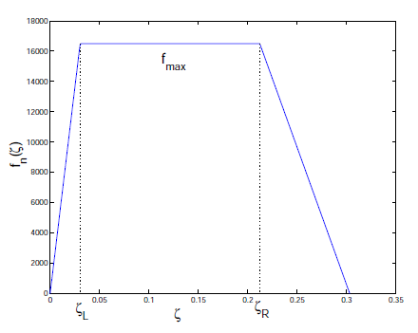



A trapezoidal normal force distribution is considered for the tire contact patch.
L
Front
Rear
Contact patch length

Slide 32
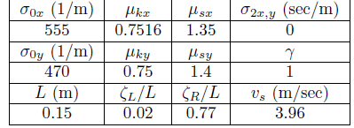
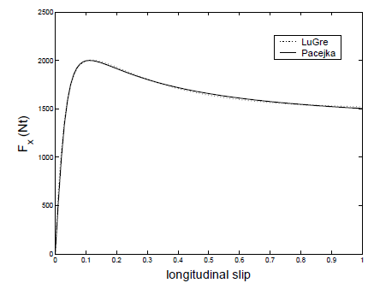
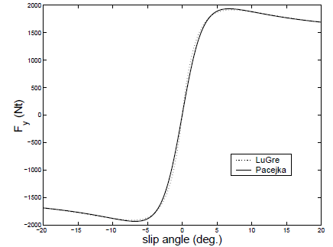
Parameters are obtained by comparing with experimental data

Slide 33
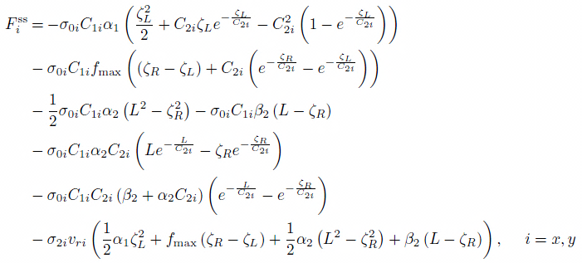
Steady-state forces are obtained for distributed LuGre model

Slide 34
Outline
Introduction
1D LuGre model
2D/Combined LuGre model
Results from combined LuGre model

Slide 35
Combined LuGre model can be used to produce friction ellipse plot

Slide 36


Shape of longitudinal friction force curve changes depending on the lateral force and vice-versa
$$α=0^{o}$$
$$α={10}^{o}$$

Slide 37
Lateral and longitudinal force curves have similar shapes over full range of slip

Slide 38
Insights: cornering stiffness does not change with the friction coefficient (e.g. on a wet road)
Nominal friction
0.75*Nominal friction
0.5*Nominal friction

Slide 39
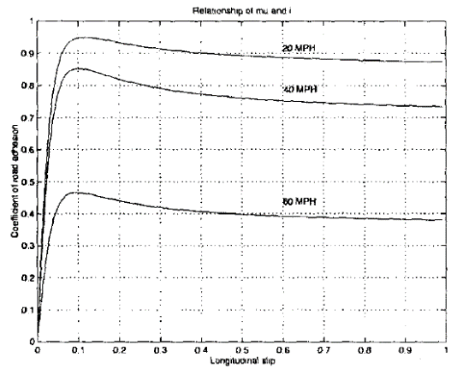
Why do we need a physics-based model with Stribeck effect?
Vehicle dynamicists typically use dry road friction for simulations and hence assume that coefficient of friction is constant
Highway design involves wet road friction. Civil engineers report friction on wet road which decreases with velocity
Stribeck effect captures both situations, as well as velocity dependence!
Figure: Coefficient of road adhesion with longitudinal slip
(Reference: De Wit et al, Dynamic Friction Models for Road/Tire Longitudinal Interaction, IEEE transactions on Automatic Control, 1999)

Slide 40
Sliding friction goes down with velocity on wet road, an effect that is captured by LuGre tire models! (but not by Magic Tire)

Slide 41
Longitudinal (or lateral) tire stiffness changes with normal load
Fn= 3000 N
Fn= 2000 N
Fn= 1000 N

Slide 42
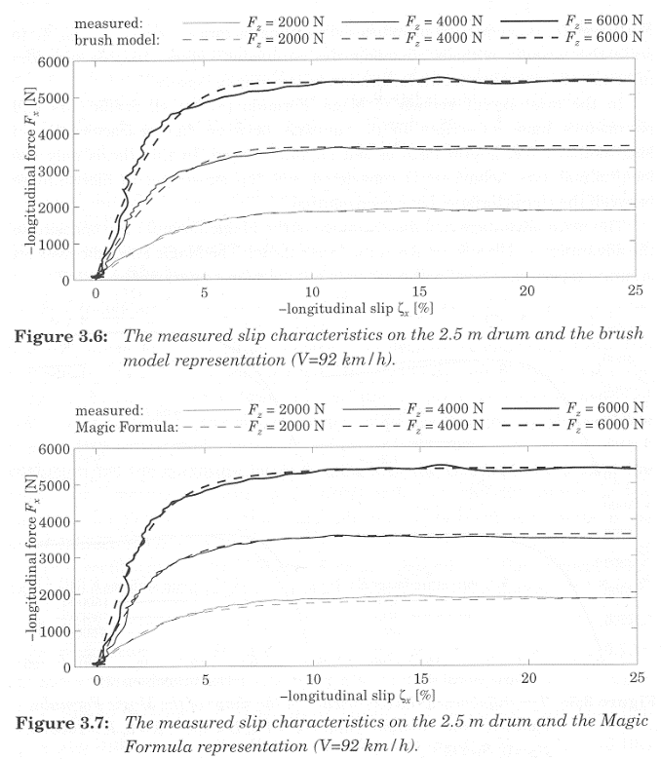
Comparison shows EXCELLENT agreement between models
Brush Model (LuGre)
ref. P. Zegelaar, “The dynamic response of tyres
to brake torque variations and road uneveness,”
Ph.D. TUDelft, 1998.
Magic Formula Model

Slide 43

For most of my advanced research work on vehicle dynamics, I prefer LuGre…

